Slide 1
Peer-graded Assignment: Course Project: Shiny Application and Reproducible Pitch
By : Joel Seah
14/6/2023

Slide 2
Purpose
To see if no of data points/bins affect the distribution of the curve

Slide 3
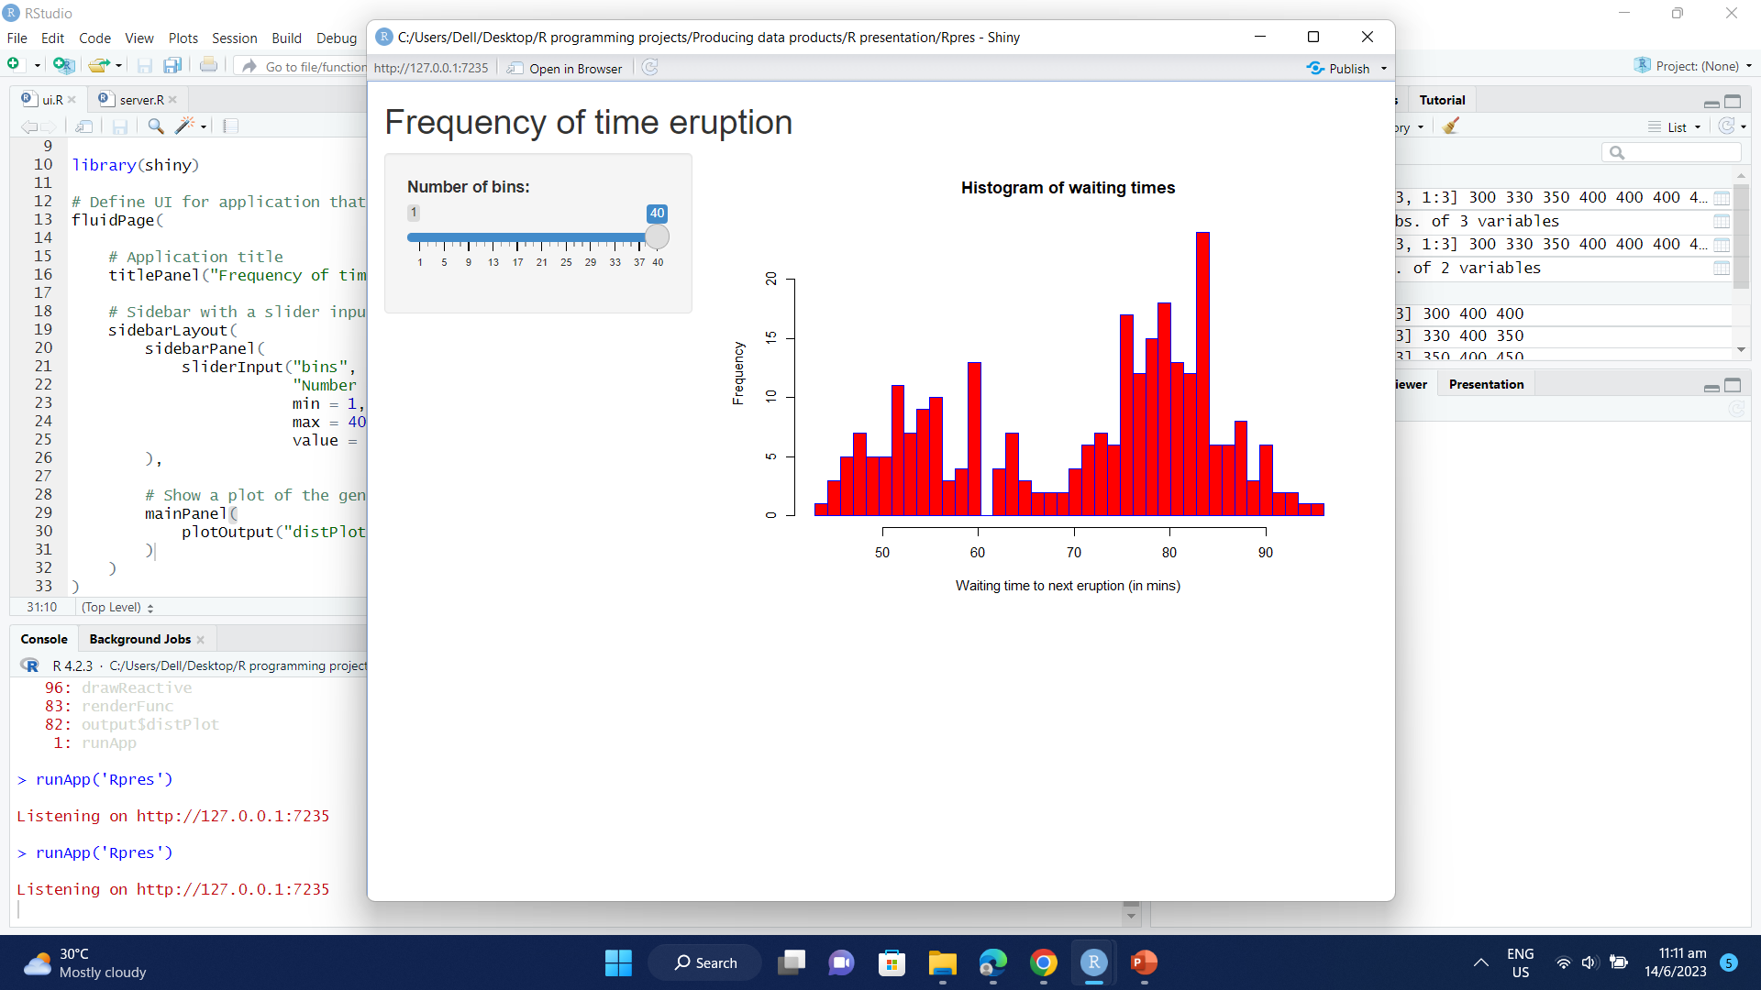
Final Product

Slide 4
Product features
Can drag the slider to change the slider and see if the graph changes

